Slide 1



“Humanization of anti-CD3 antibody using protein language model ”
DISSERTATION REPORT
Superviser: Dr. Tanveer Ahmad Assistant Professor MCARS Jamia Millia Islamia
Presented by:
JUVERIA REHMAN
M.Sc. Virology
Roll no. – 22MMV005
Enrollment no. - 22-082113

Slide 2
CD-3{ Cluster of Differentiation 3}
Structure-The CD3 complex is composed of several subunits:
CD3ε (epsilon)
CD3γ (gamma)
CD3δ (delta)
CD3ζ (zeta)
These subunits form a complex that associates with the TCR. The TCR is responsible for recognizing antigens presented by the Major Histocompatibility Complex (MHC) on antigen-presenting cells.
CD3 (Cluster of Differentiation 3) is a complex of proteins associated with the T cell receptor (TCR) on the surface of T lymphocytes (T cells).
It is crucial for the activation and function of T cells, which are essential for adaptive immunity.
Function: CD3 is essential for transmitting signals from the TCR to the inside of the T cell after the TCR recognizes and initiate a cascade of intracellular events that leads to T cell activation.
Effector Functions: Activated T cells perform various functions, including killing infected cells (cytotoxic T cells) and helping other immune cells (helper T cells).
Activation of T Cells: When an antigen binds to the TCR, the CD3 complex initiates a signaling cascade that leads to T cell activation, proliferation, and differentiation. This is crucial for mounting an effective immune response.

Slide 3
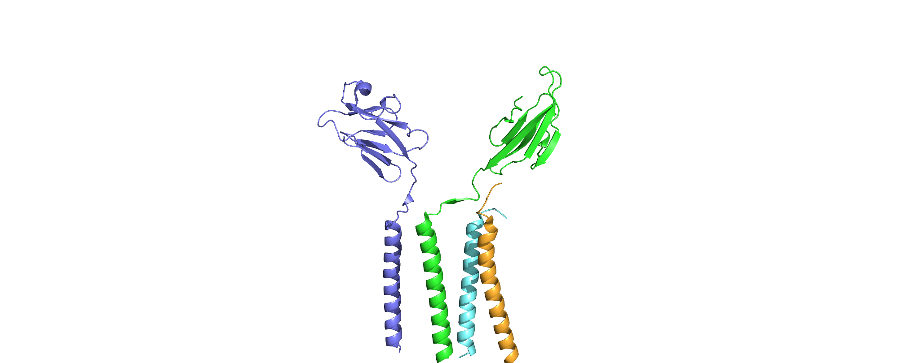
Structure of CD3 [PDB ID-6JXR]
Epsilon chain
Delta chain
Zeta chain
Gamma chain

Slide 4
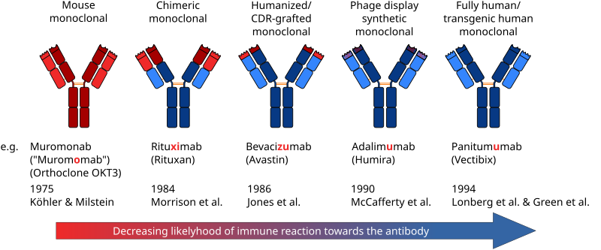
DIFFERENT TYPES OF ANTIBODIES

Slide 5
ANTIBODIES INTERACTING WITH CD3
OKT3 Fab Fragment
[PDB ID-1SY6]
UCHT1[PDB ID-1XIW]
Type: Monoclonal Antibody
Source: Mouse
Target: Human CD3 epsilon (ε) subunit of the TCR complex
Clinical Use and Effects
Immunosuppression :By binding to CD3 and activating T cells, OKT3 initially triggers a strong immune response. This is followed by a phase of T cell depletion due to apoptosis (programmed cell death) and other mechanisms, leading to overall immunosuppression.
T Cell Depletion:After the initial activation phase, OKT3 binding leads to the internalization and degradation of the CD3-TCR complex. This process renders T cells non-functional and ultimately results in their depletion from the circulation.
Type: monoclonal antibody.
Source: murine monoclonal antibody.
Target: Specifically binds to the CD3 epsilon chain.
Clinical Importance
Immunotherapy: UCHT1 is used in research and therapeutic contexts, particularly in the study of T cell activation and in developing T cell-based therapies.
Cancer Treatment: By enhancing T cell activation, UCHT1 can potentially improve immune responses against tumors.
Autoimmune Diseases: Investigating its role can provide insights into conditions where T cell activation is dysregulated.

Slide 6
WHAT IS HUMANIZATION
In structural biology, the term "humanization" often refers to the process of changing proteins or other macromolecules to more closely resemble those found in humans.
The goal of humanization is to minimize immunogenicity when using non-human antibodies as treatments by making them more similar to human antibodies, which are frequently generated from mice.

Slide 7
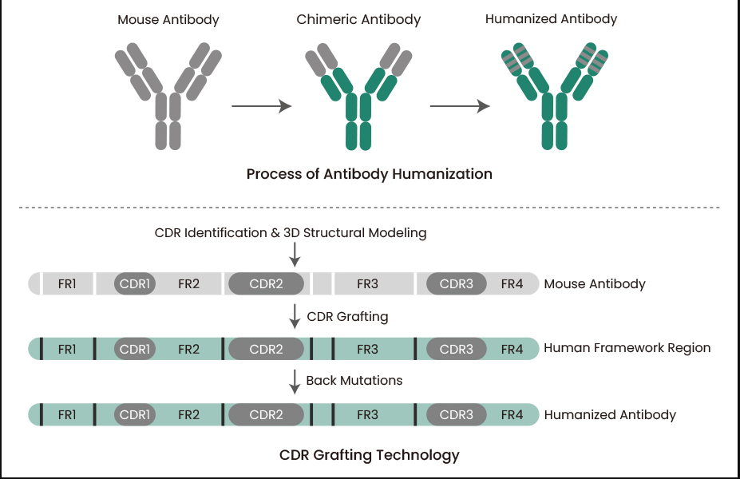
HUMANIZATION-CDR GRAFTING

Slide 8
HUMANIZATION USING PROTEIN
LANGUAGE MODEL-BIOPHI

Slide 9
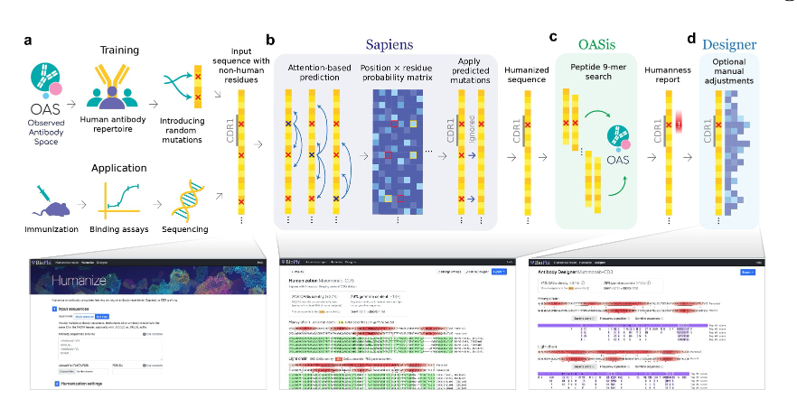
BIOPHI PIPELINE FOR BULK HUMANIZATION
figure :BioPhi integrated pipeline for bulk humanization (Sapiens) and humanness evaluation (OASis).Sapiens is trained on human variable region antibody sequences from the OAS. Random positions in unaligned amino acid sequences are masked or mutated,Sapiens is trained to recognize and repair them. This simulates the real-world application where sequences with non-human residues originate from immunized mice,rabbit, or other species.

Slide 10
METHODOLOGY WORKFLOW
Fetch the structure of ligand OKT3 Antibody and receptor CD3 using PDB ID in Pymol
Humanization
Evaluating
Energy Minimization
Heat Production
Structural processing
leap
Running MD Simulation using AMBER Force Fields
AbRSA tool for identification of CDR regions in heavy and light chains
Evaluate antibody humanness using BIOPHI
Post MD Simulation Analysis
Trajectory Analysis
Visualizating binding Epitope by Pymol
PCA
RMSD
RMSF
Binding Energy
MM GBSA
Homology modelling to predict the 3D structure by mod10.5 software
MM PBSA
Interaction
CPPTRAJ
Aligning Receptor and Ligand sequences using Clustal Omega
DOPE score and GA341 assessment score is evaluated for best fit modelled structure
Salt bridge
Hydrogen bond
Future potential

Slide 11
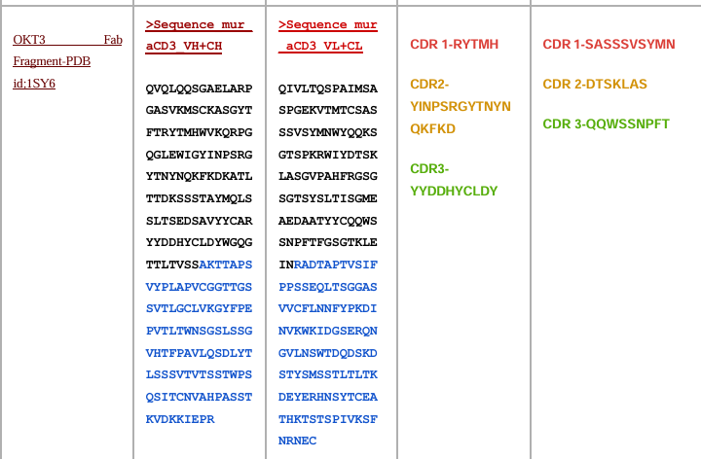
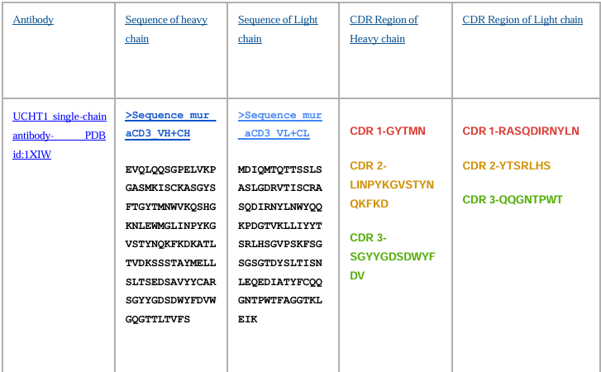
DIFFERENT ANTIBODIES SEQUENCES RELATED TO CD3

Slide 12
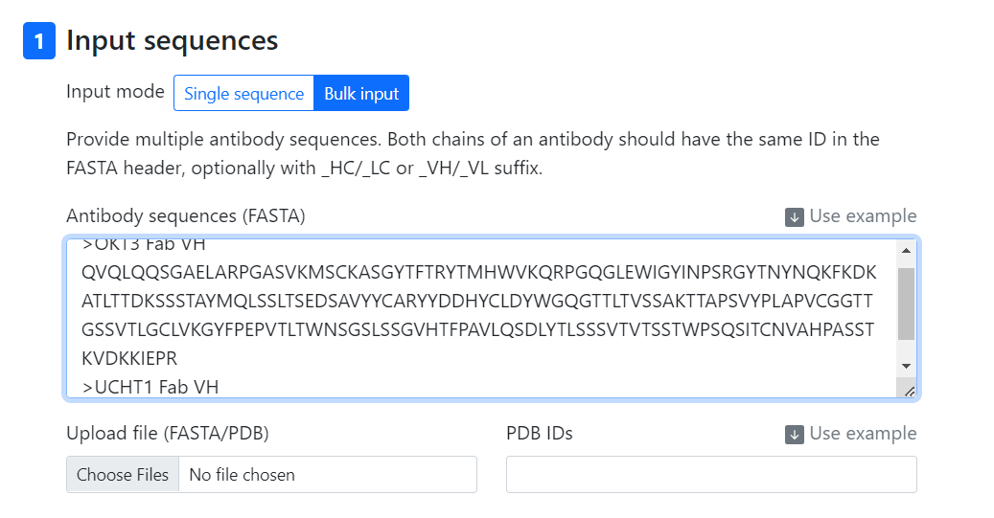
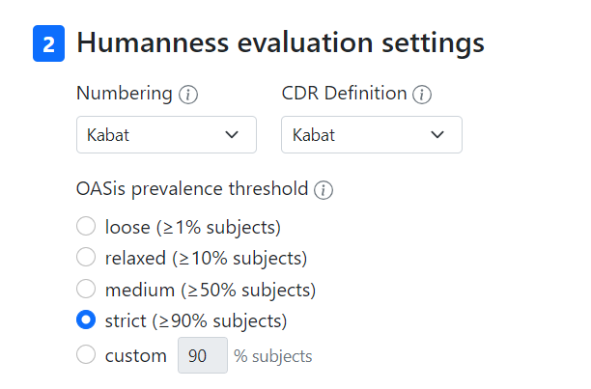
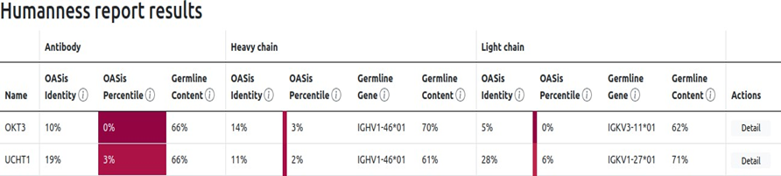
Humanness Evaluation

Slide 13
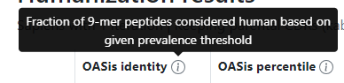
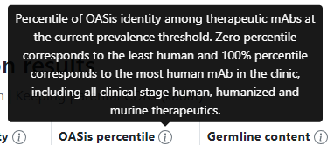
Biophi humanness Report
1SY6: OKT3 Fab Fragment
1XIW :UCHT1 Antibody

Slide 14
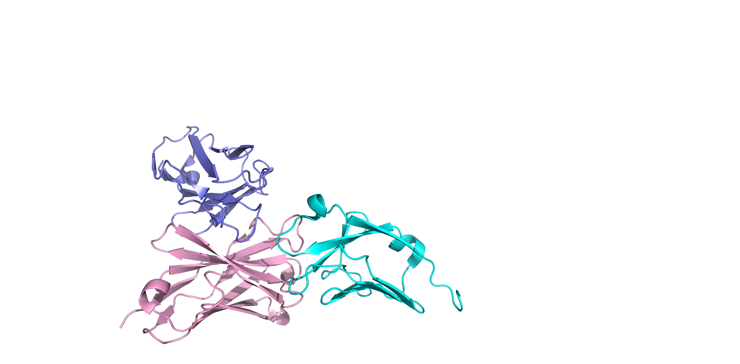
STRUCTURE OF CD3 WITH OKT3 Fab
Light chain
Epsilon chain
Heavy chain
Epsilon chain of CD3 interacting with the Antibody heavy chain

Slide 15
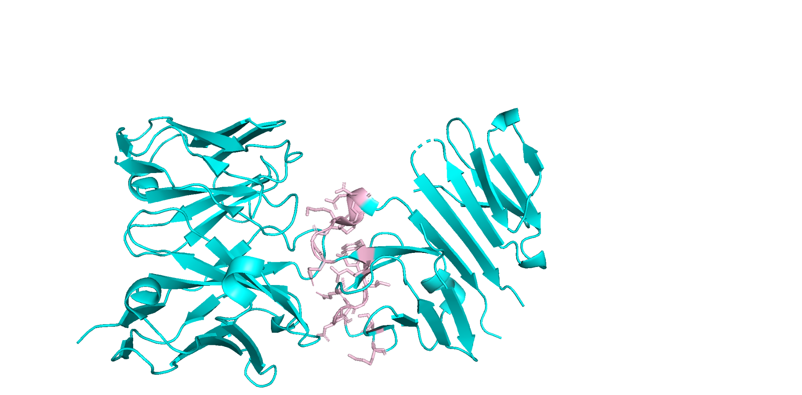
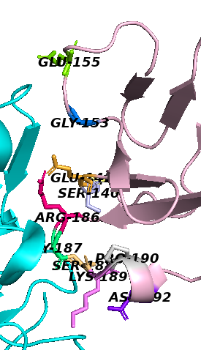
BINDING REGION OF CD3 (Epsilon chain)
The stick form represents the interacting residues

Slide 16
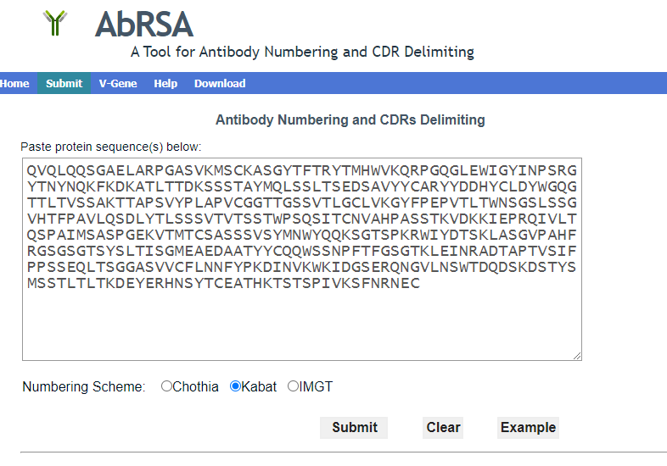
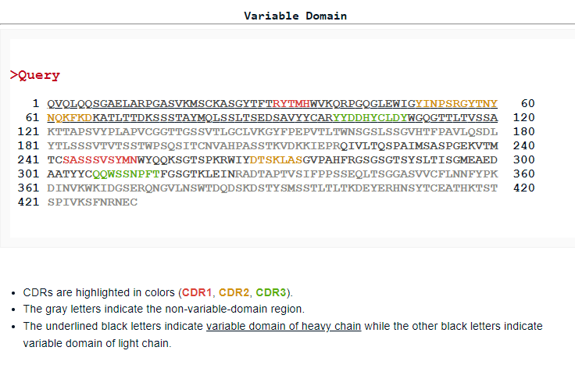
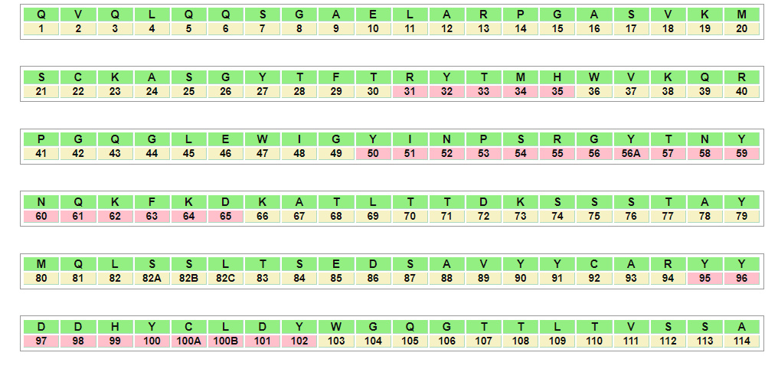
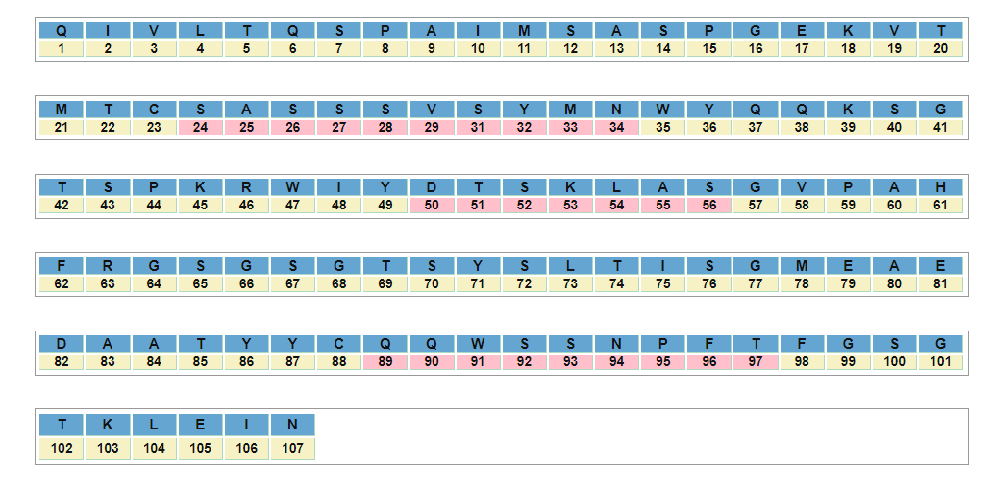
AbRSa (A Tool for Antibody Numbering and CDR Delimiting)
HEAVY CHAIN
LIGHT CHAIN

Slide 17
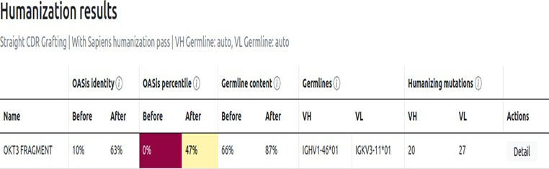
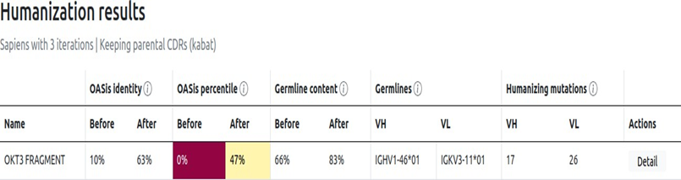
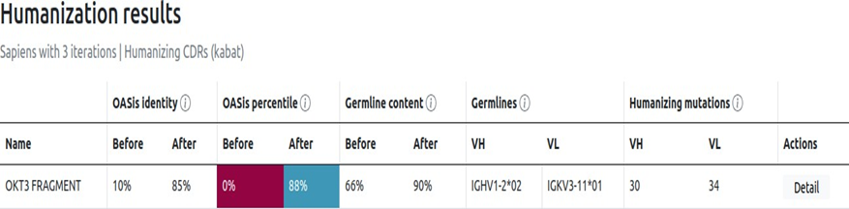
Humanization Methods
CDRs Grafting + SAPIENS(iterations 3)
SAPIENS (iterations 3)
SAPIENS (iterations 3) +CDRs Mutations

Slide 18
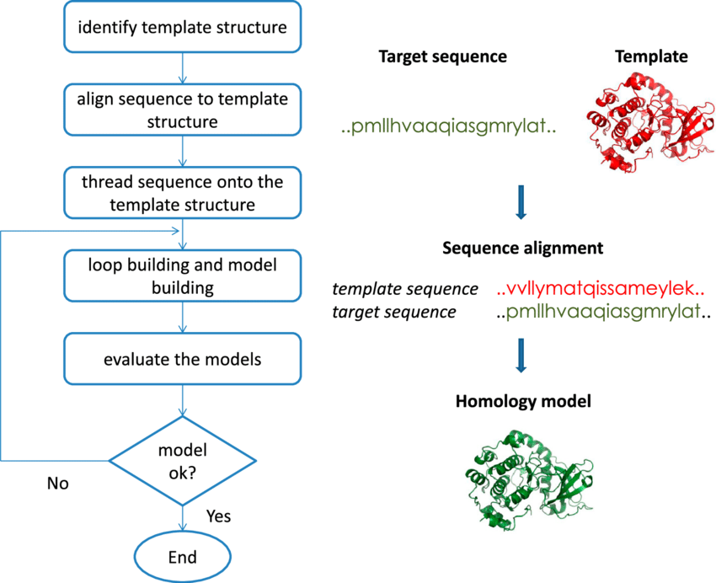
HOMOLOGY MODELLING
Basis: Homology modeling relies on the evolutionary relationship between proteins. It predicts the structure of a protein (the target) based on its similarity to one or more known structures of related proteins (templates).
Tools: Common software for homology modeling includes MODELLER.

Slide 19
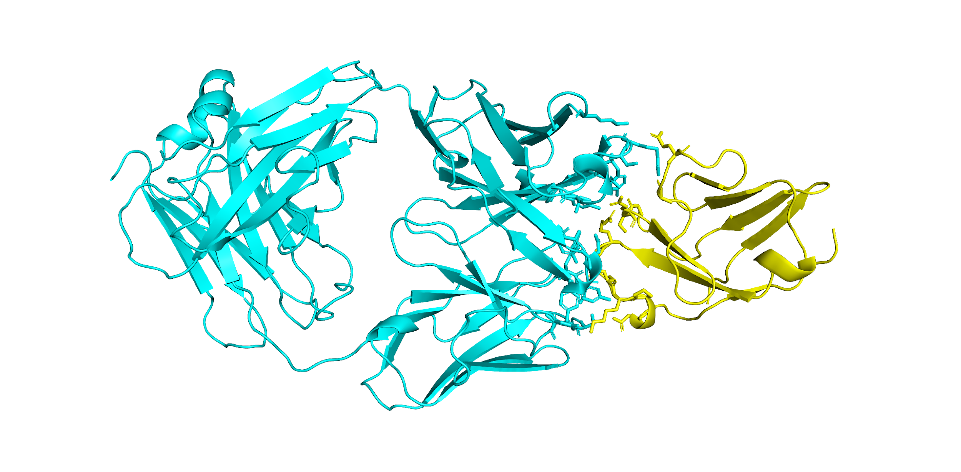
Modelled structure of OKT3 Fab with CD3
Ligand-OKT3 Fab
Receptor-CD3

Slide 20
INTERACTING RESIDUES
MURINE OKT3 FAB RESIDUES | CD3 RESIDUES
SER31 | LYS509
SER31 | ASP512
TYR32 | GLY507
TYR32 | LYS509
TRP91 | GLY507
ASN94 | SER460
ARG247 | GLU472
TYR266 | GLU461
ARG247 | ASP477

Slide 21
MOLECULAR DYNAMICS SIMULATIONS
Molecular Dynamics (MD) Simulation is a computer simulation method for studying the physical movements of atoms and molecules.
These simulations can capture a wide variety of important biomolecular processes, including conformational change, ligand binding, and protein folding, revealing the positions of all the atoms at femtosecond temporal resolution.
By determining the positions of every atom in a biomolecular system, such as a protein encircled by water and maybe a lipid bilayer, one can compute the force that every other atom applies to every other atom.
The core of MD simulations involves solving Newton’s equations of motion for all the atoms in the system to predict their future positions and velocities.
The output of an MD simulation includes trajectories of atoms, which can be analyzed to obtain properties like radial distribution functions, diffusion coefficients, and conformational changes.
Popular MD simulation software includes AMBER.

Slide 22
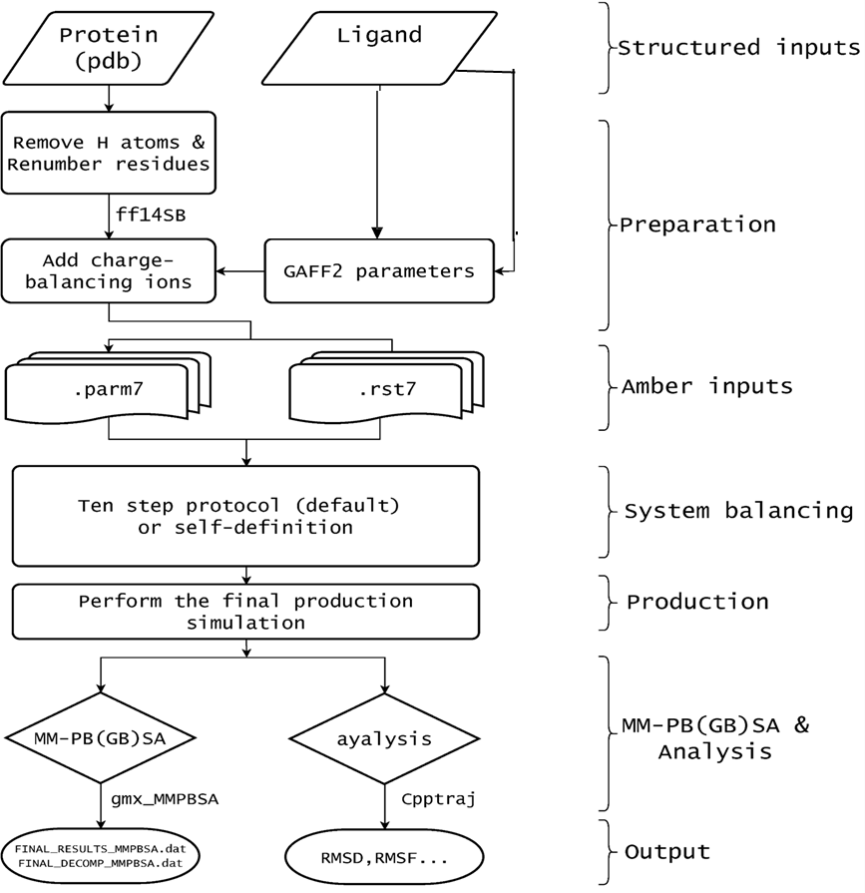
AMBER
AMBER (Assisted Model Building with Energy Refinement) is a suite of software tools used primarily for molecular dynamics (MD) simulations of biomolecules.
It is widely utilized in computational chemistry and structural biology for studying proteins, nucleic acids, lipids, and small molecules.
The AMBER software package includes a variety of programs and utilities designed to facilitate different aspects of molecular modeling and simulation.

Slide 23
PERFORMING MD SIMULATION
Perform MD simulation using AMBER force field
Directories
Structure processing(capping of terminals)
Generating topology parameter files and Coordinate files using tLeap
Energy Minimization to remove bad contacts
Heat-production
Final run for 200ns
Post MD simulation Analysis
Perform all steps as per protocol

Slide 24
POST MD SIMULATION ANALYSIS
CPPTRAJ is a powerful command-line tool used for analyzing molecular dynamics (MD) simulation trajectories. It is part of the Amber Tools suite and is particularly useful for examining the structural and dynamical properties of biomolecular systems.
Structural Analysis
Root Mean Square Deviation (RMSD): Measure the deviation of the molecular structure from the initial configuration over time.
MM/PBSA (Molecular Mechanics/Poisson-Boltzmann Surface Area): Estimate binding free energies.
MM/GBSA (Molecular Mechanics/Generalized Born Surface Area): Similar to MM/PBSA but uses the GB model for solvation.
Binding Free Energy Calculations

Slide 25
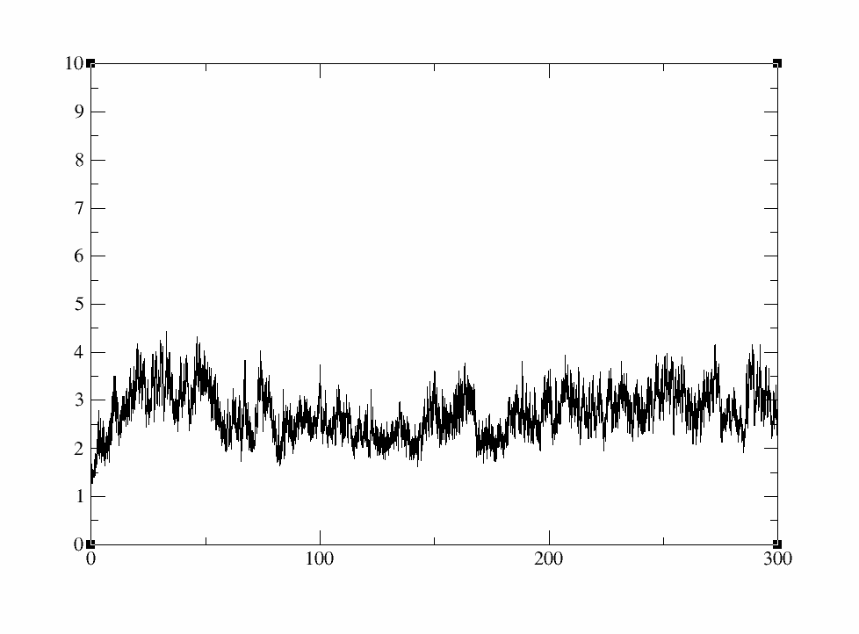
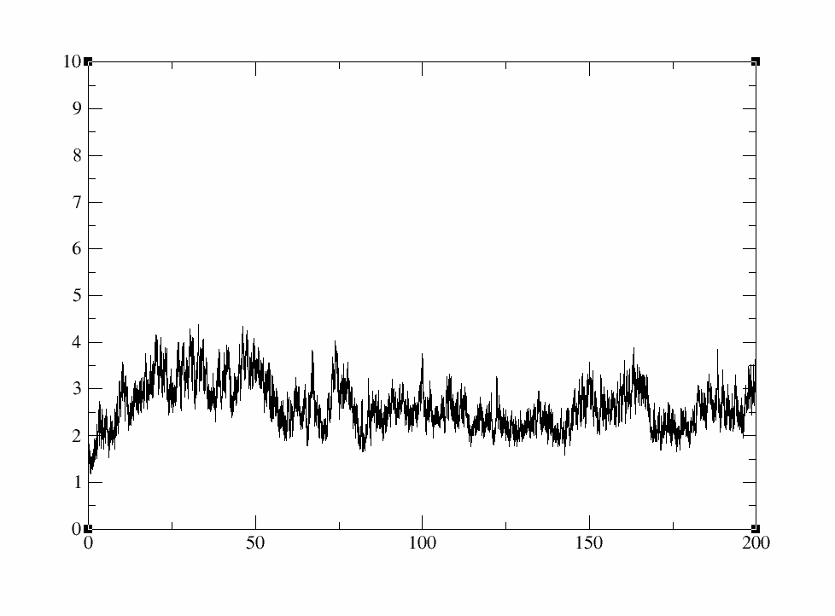
ROOT MEAN SQUARE DEVIATION RESULTS OF MURINE OKT3 Fab
RMSD(A)
RMSD(A)
time(ns)
time(ns)
RMSD RESULT FOR 200NS
RMSD RESULT FOR 300NS

Slide 26
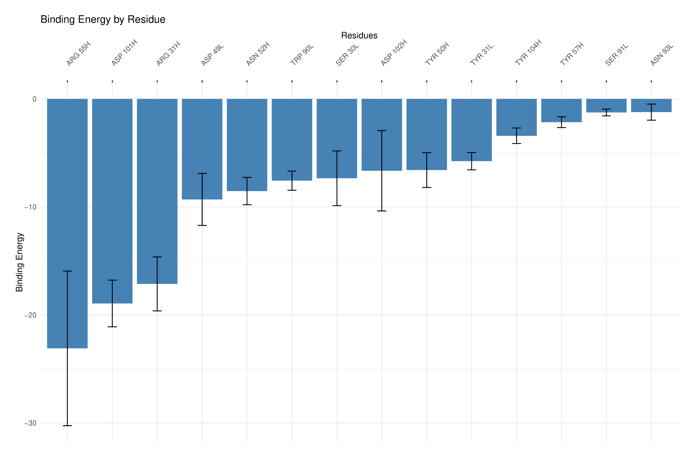
Binding Energy per Residue Barplot
MURINE OKT3 Fab
BINDING ENERGY
Antibody-OKT3 Fragment | Binding Energy (kcal/mol)
Mur-OKT3 Fab | -66.4245 +/- 8.6509
Fig-This bar plot indicates Binding energy on Y axis and Residues on X axis highlighting Arginine (ARG 55H) in heavy chain has the highest binding energy.

Slide 27
HUMANIZING OKT3
Template sequence
Query sequence
PDB FORMAT structure from PDB
Humanize fasta sequence of OKT3 from BIOPHI
AlphaFold2.ipynb for prediction of 3D structure of humanized OKT3
Post analysis of MD Simulation
Recomformation through Ramachandran Plot using Saves v6.1 tool
Run MD SIMULATION using AMBER force fields

Slide 28
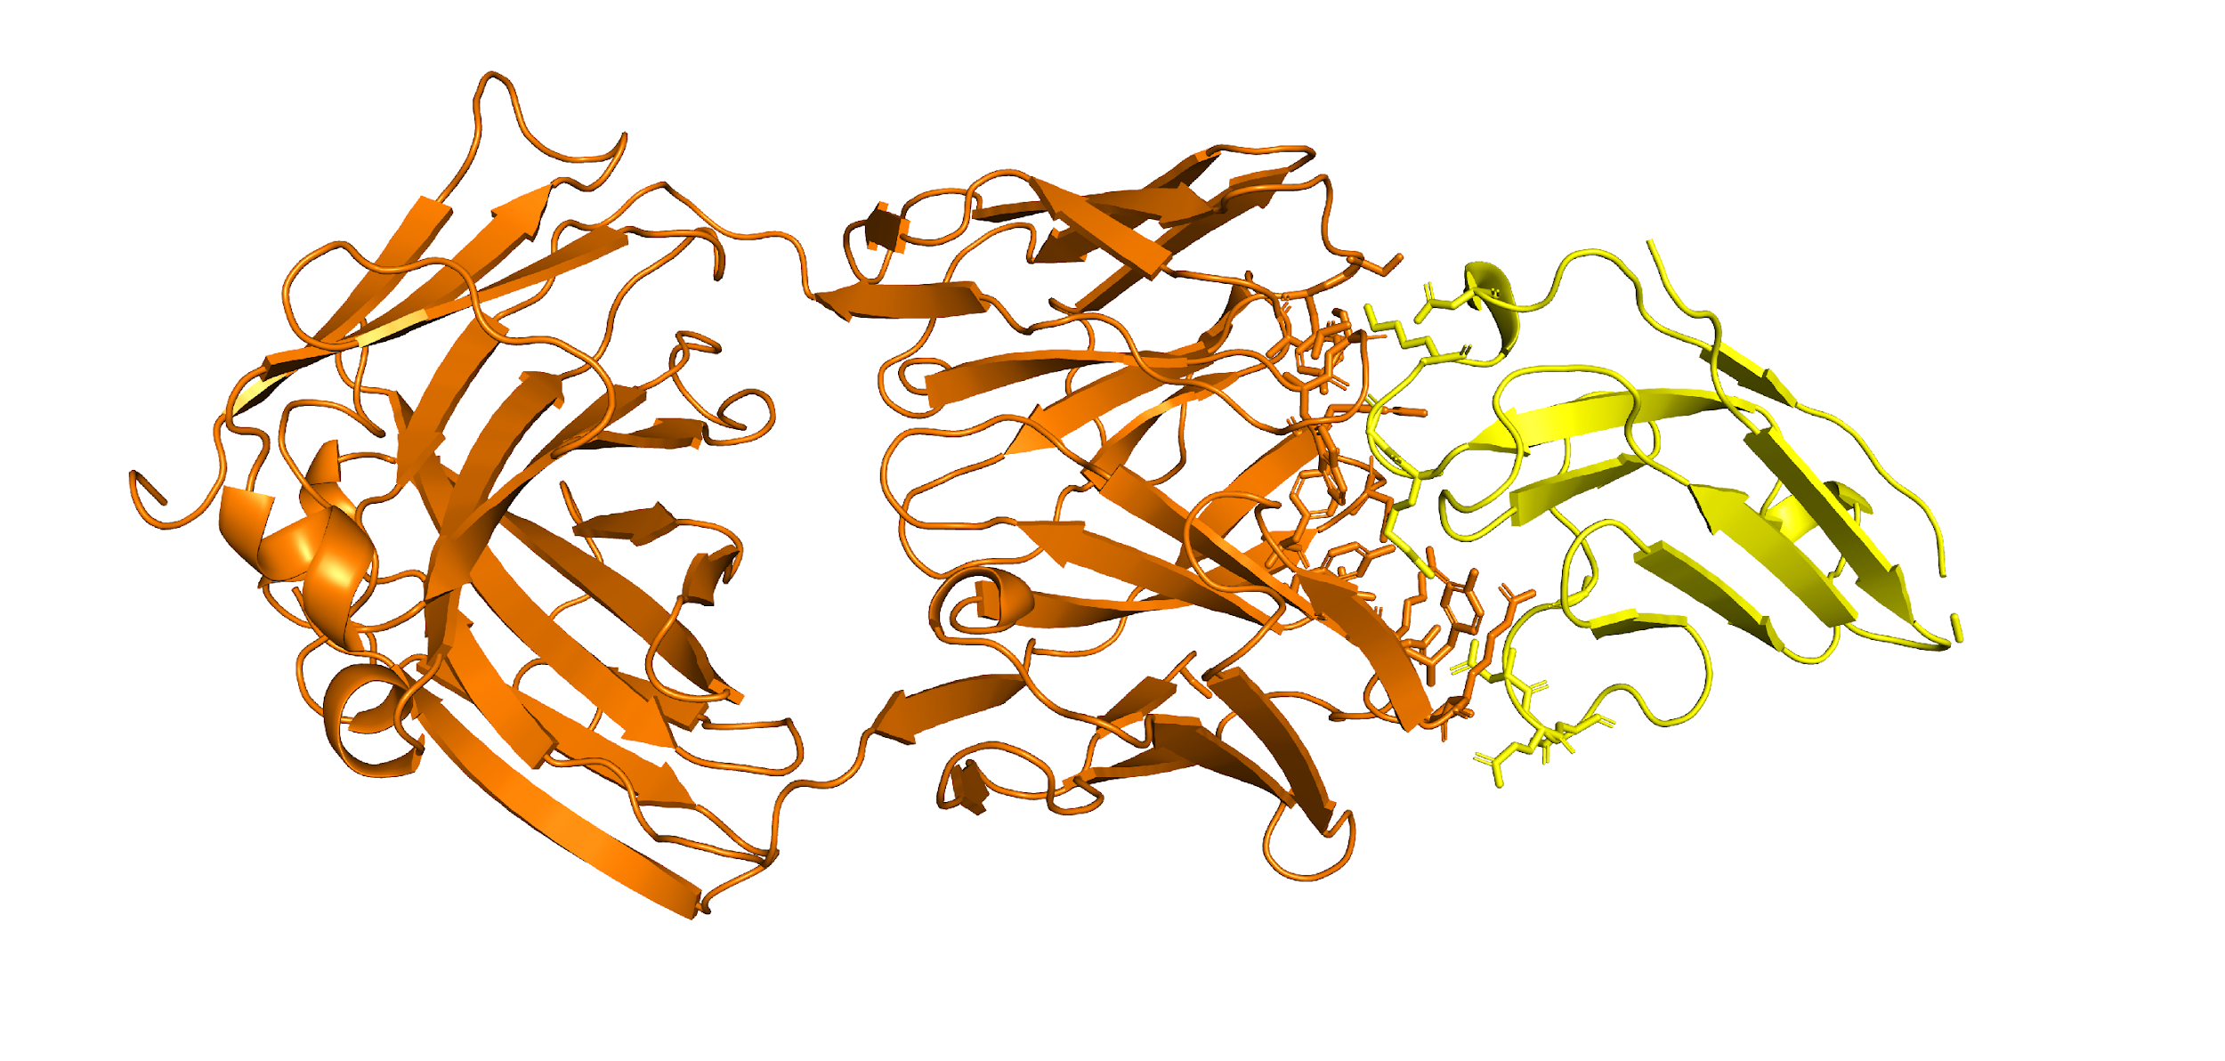
Alpha fold predicted Humanized OKT3 structure
LIGAND- HMZ-MOD- OKT3
RECEPTOR-CD3

Slide 29
INTERACTING RESIDUES
HUMANIZED OKT3 FAB RESIDUES | CD3 RESIDUES
SER31 | ASP512
TYR32 | LYS509
TRP91 | ARG506
SER92 | ASP512
ARG247 | GLU475
ARG247 | ASP476
TYR266 | GLU461

Slide 30
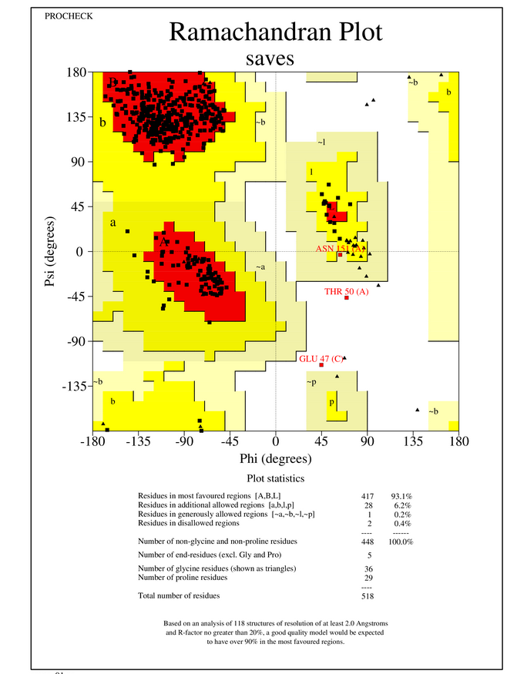
RAMACHANDRAN PLOT FOR STRUCTURE VALIDATION
A Ramachandran plot with 93.1% of residues in the favored region indicates that the protein structure has a high level of conformational quality. The favored region represents the most energetically favorable phi (φ) and psi (ψ) torsion angles for amino acid residues.

Slide 31
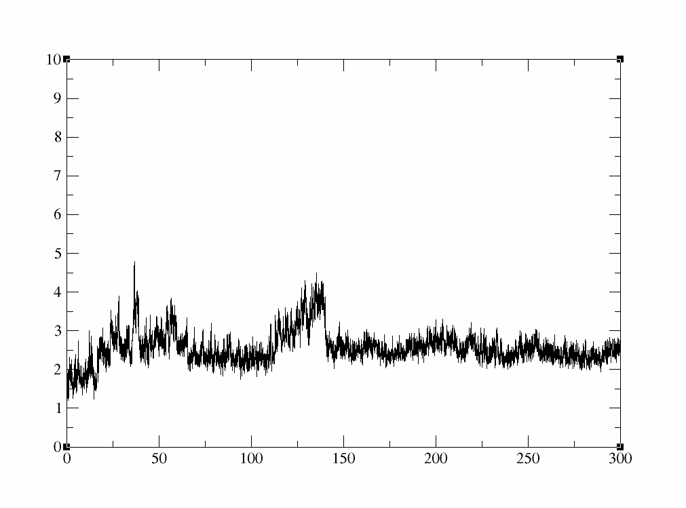
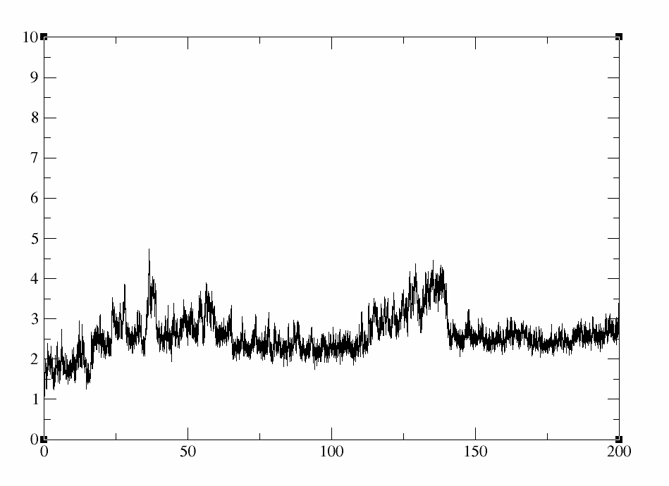
ROOT MEAN SQUARE DEVIATION RESULTS OF HUMANIZED OKT3 Fab
RMSD(A)
RMSD(A)
time(ns)
time(ns)
RMSD RESULT FOR 200NS
RMSD RESULT FOR 300NS

Slide 32
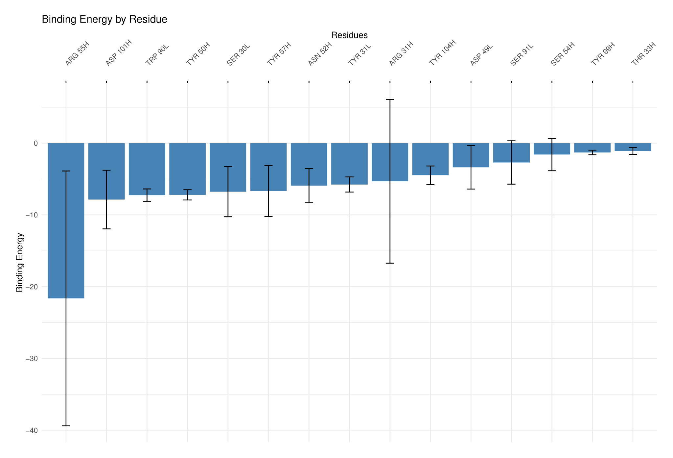
HUMANIZED OKT3 Fab
Binding Energy per residue Barplot
BINDING ENERGY
Antibody-OKT3 Fragment | Binding Energy (kcal/mol)
Hmz-OKT3 Fab | -51.8483 +/- 10.5878
Fig-This bar plot indicates Binding energy on Y axis and Residues on X axis highlighting Arginine (ARG 55H) in heavy chain has the highest binding energy.

Slide 33
CONCLUSION
The humanization of OKT3 from its murine counterpart demonstrates a satisfactory balance in binding energy, with humanized OKT3 showing a binding energy of -51 kcal/mol compared to -66 kcal/mol for murine OKT3. This indicative difference of reduced binding affinity, is still within an acceptable range, suggesting that humanized OKT3 retains sufficient efficacy for further clinical evaluation. This advancement could lead to improved therapeutic applications with reduced immunogenicity in human patients.
In conclusion, the humanization of antibodies against CD3 using a protein language model depicts a significant advancement and contribution to the future of antibody engineering, and leading to potential new therapeutic applications in the development of new therapeutics and advancing precision medicine.

Slide 34
FUTURE PERSPECTIVE
The future perspectives for humanized OKT3, derived from murine OKT3, are promising, particularly for further in vivo studies to evaluate its therapeutic potential and safety in clinical settings.
Testing humanized OKT3 in various models could refine its efficacy and optimize its immunogenicity profile, paving the way for its use in treating conditions like transplant rejection and autoimmune diseases.
This approach may not only enhance understanding of its mechanisms but also improve treatment outcomes, positioning humanized OKT3 as a valuable option in immunotherapy.

Slide 35
THANK YOU

